Slide 1






Welcome!
dO yOu NeEd HeLp wiTh ThAt?
Anna, Dauren, aTHENA. Himangshu, m0ritz

Slide 2
Methadone Prices on the Black Market Across the United States
(just kidding)
IDS702 Team Project Group Yellow

Slide 3
Outline
Data Background
Process
Data Cleaning
EDA
Linear Model Fitting
Hierarchical Model Fitting
Interpretations
Conclusion
TODO: update all tables

Slide 4

Data & Modeling Process
StreetRx: Crowdsourced data on diverted prescription drugs
Unreliable data inputs
Data Cleaning
StreetRx User
EDA
Linear Model Fitting
Hierarchical Model Fitting
Interpretations
Notes:
Moritz

Slide 5

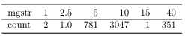
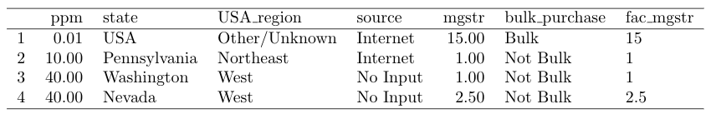
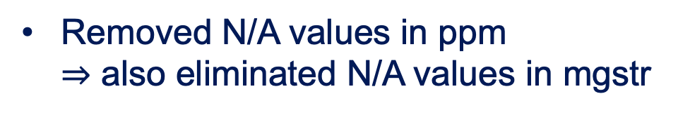

Data Cleaning
Consolidation of source
Missing values
Removed N/A values in ppm
$⇒$ also eliminated N/A values in mgstr
Internet
http://...
Google
Pharmacy
StreetRx
Internet
Levels of mgstr
Heard it
Blanks
N/A
None
No Input
Personal
Removed uncommon mgstr & factorized it
to pay $40/mg for Methadone
Notes:
Moritz

Slide 6
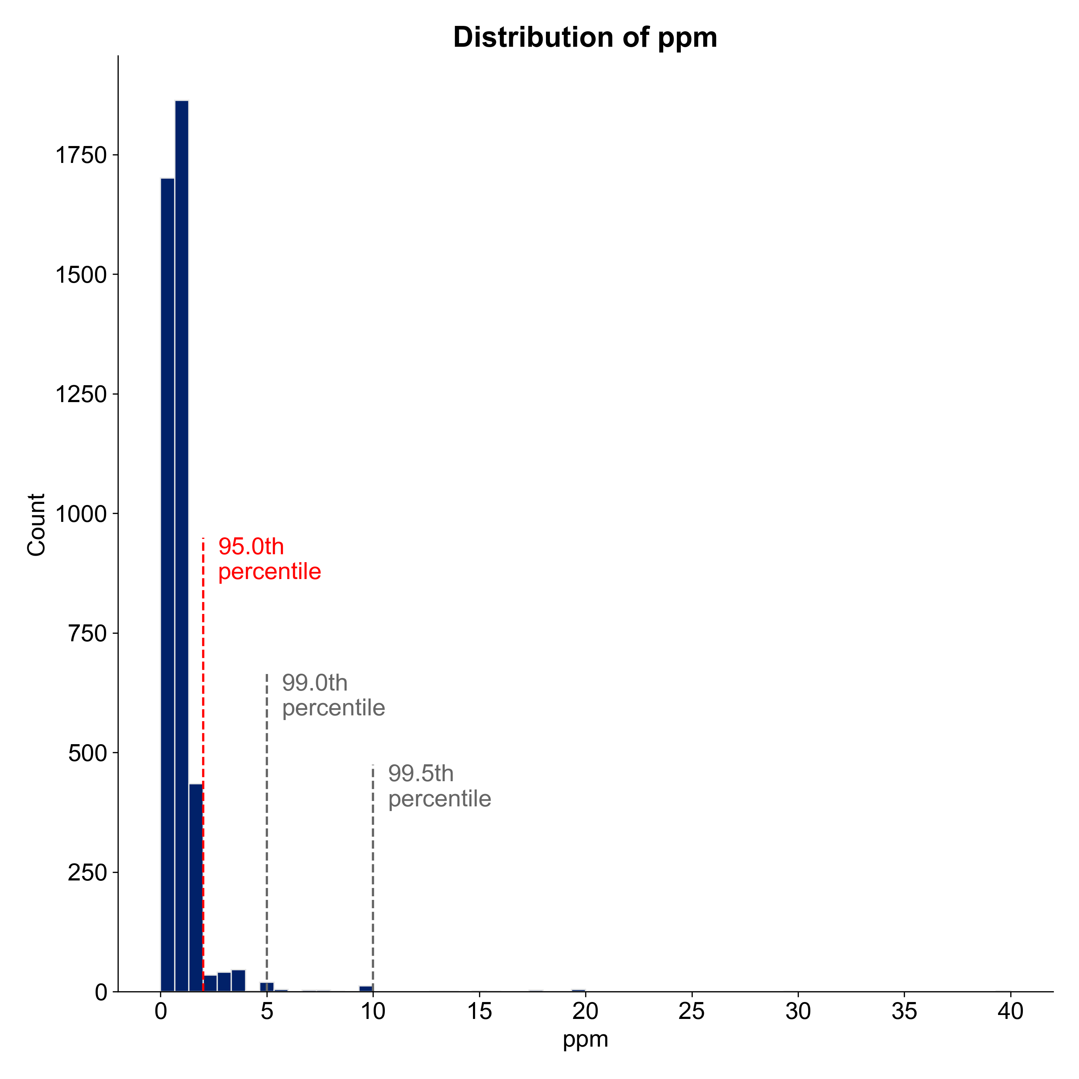
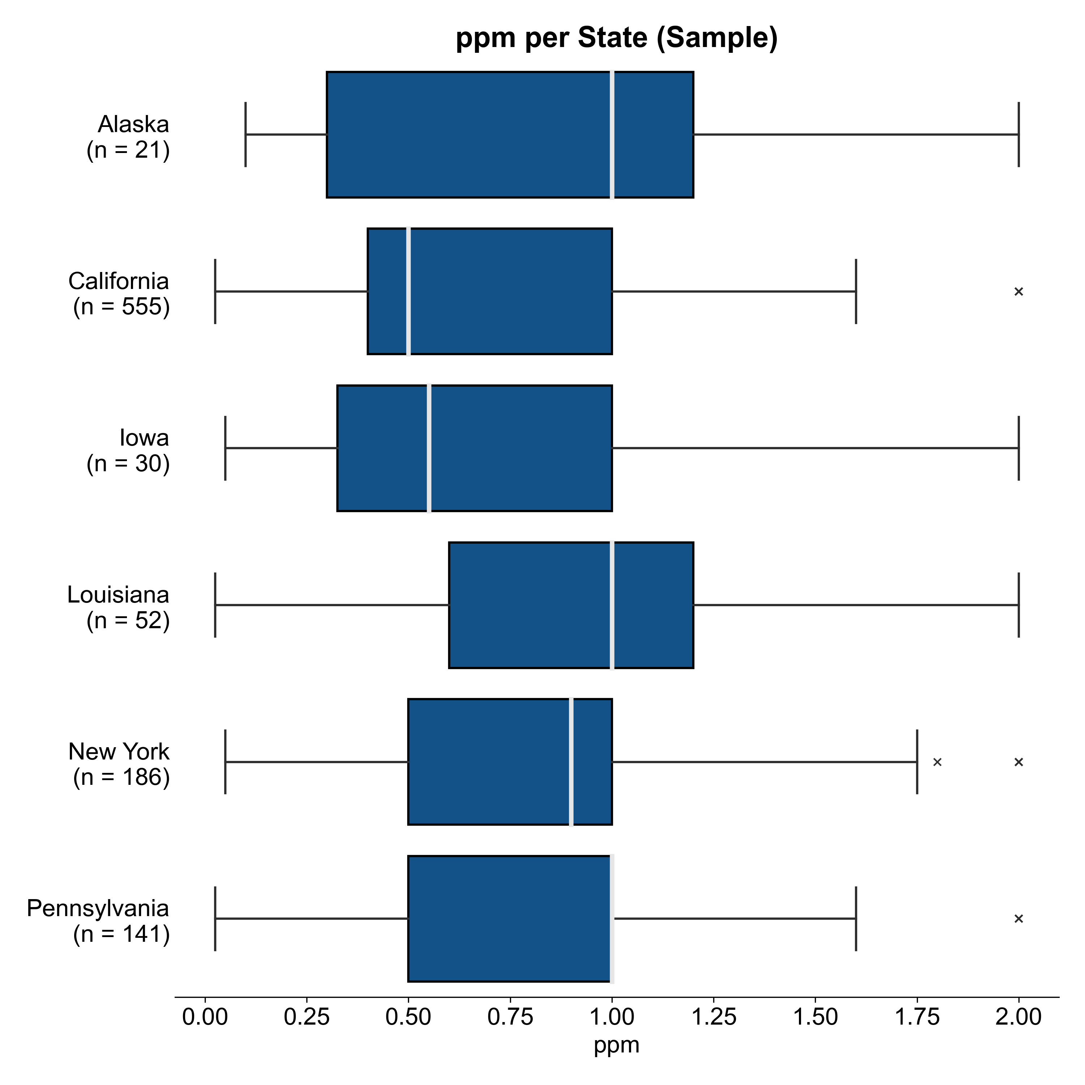
EDA
Distribution of price per mg
Distribution by location
Removed 181 outliers
> 95th percentile
(cutoff at $2/mg)
Notes:
Moritz

Slide 7
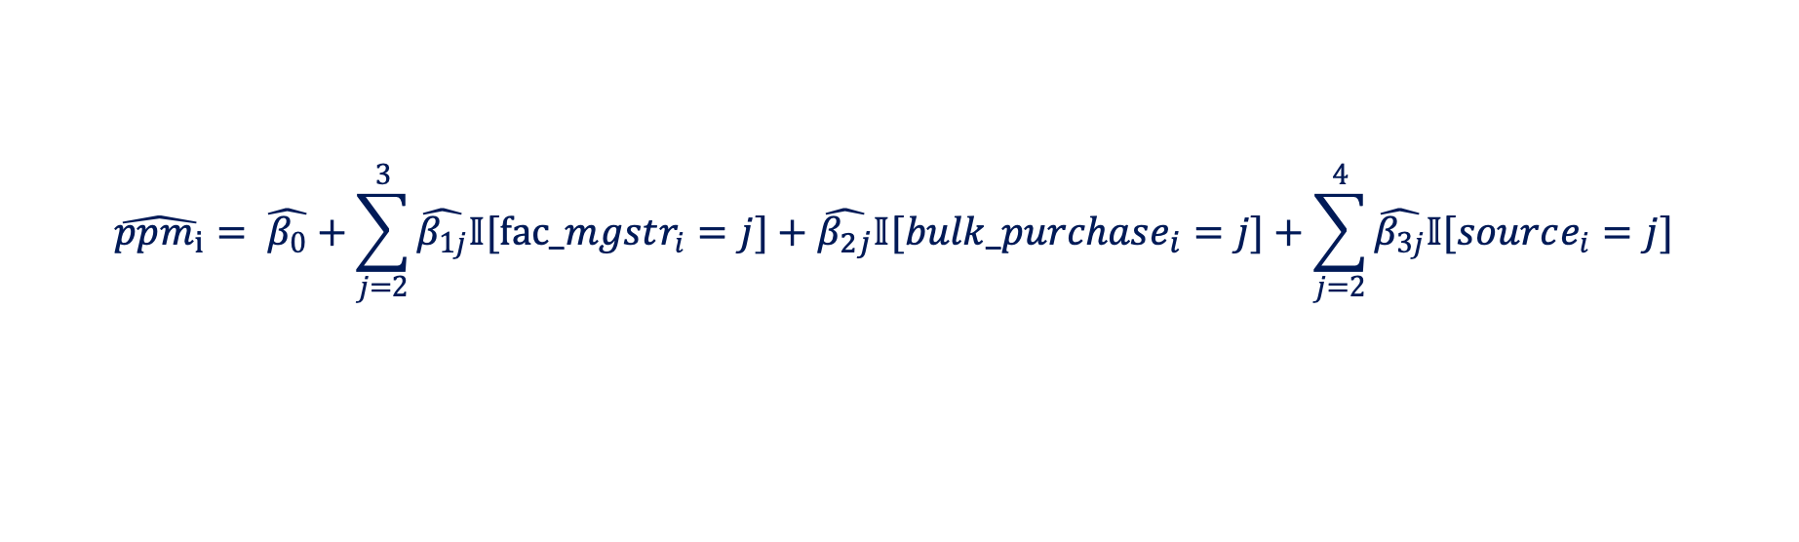
Linear Model Fitting
Null Model
Intercept only
Full Model
All non-location predictors
Parameters
AIC
Direction = both
Final first level model
$$\hat{ppm_{i}}= \hat{β_{0}}+\sum_{j=2}^{3}{\hat{β_{1j}}𝕀[fac_mgstr_{i}=j]}+\hat{β_{2j}}𝕀[bulk_purchase_{i}=j]+\sum_{j=2}^{4}{\hat{β_{3j}}𝕀[source_{i}=j]}$$
Model assessment
Hmm how to present here
Notes:
Moritz

Slide 8
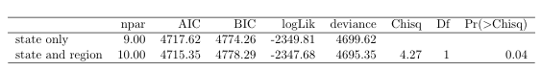

Hierarchical Model Fitting
Testing by state and region against by state only
table AIC, region only, state only, vs state & region
test state only against state & region
final Model equation and assessment?
Notes:
Moritz

Slide 9
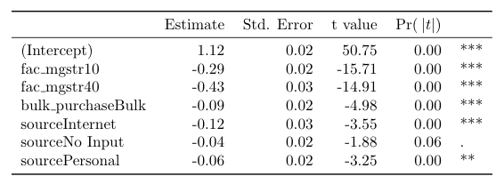
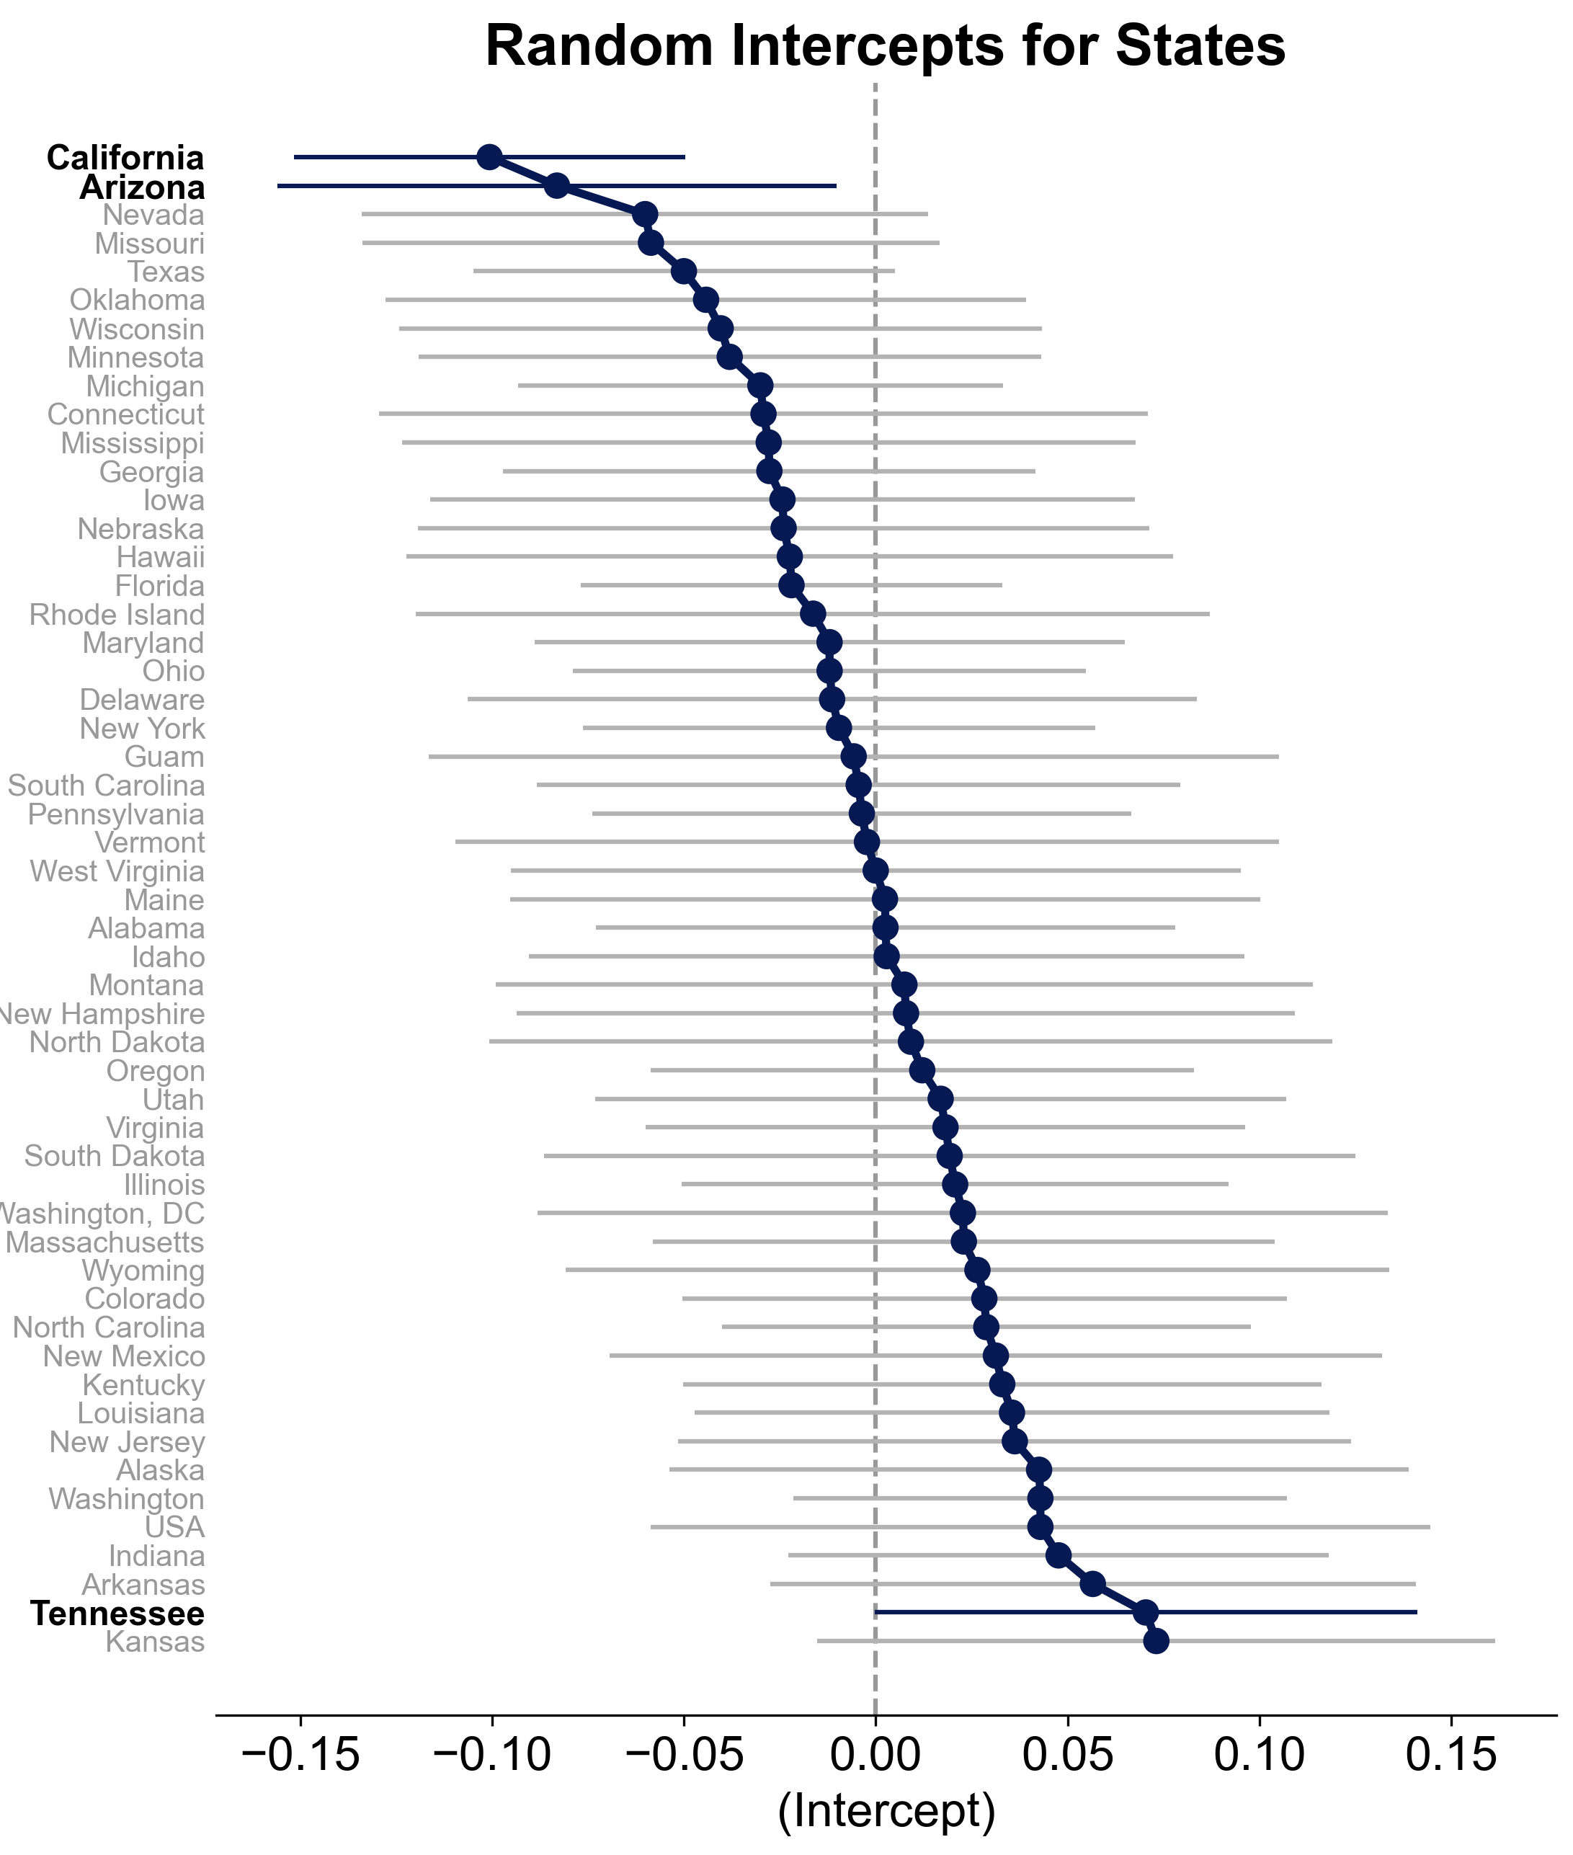
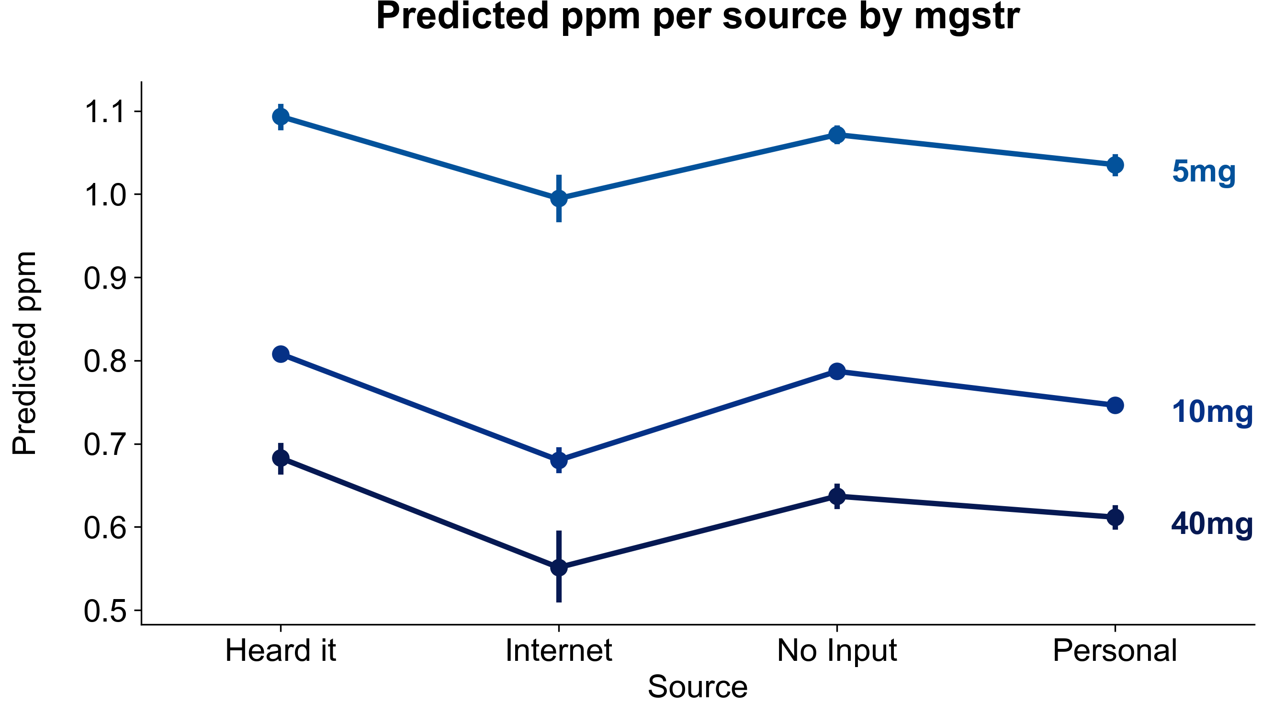

Interpretation
Fixed effects
Random effects: state level
Notes:
Moritz

Slide 10
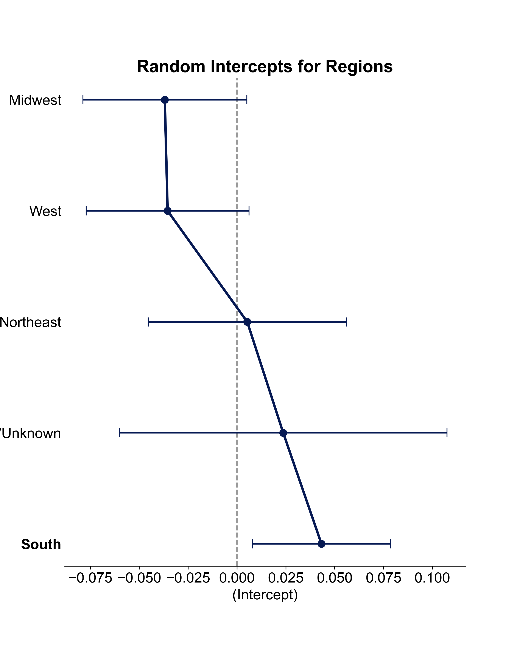


Interpretation
Random effects: region level
Summary
Notes:
Moritz

Slide 11
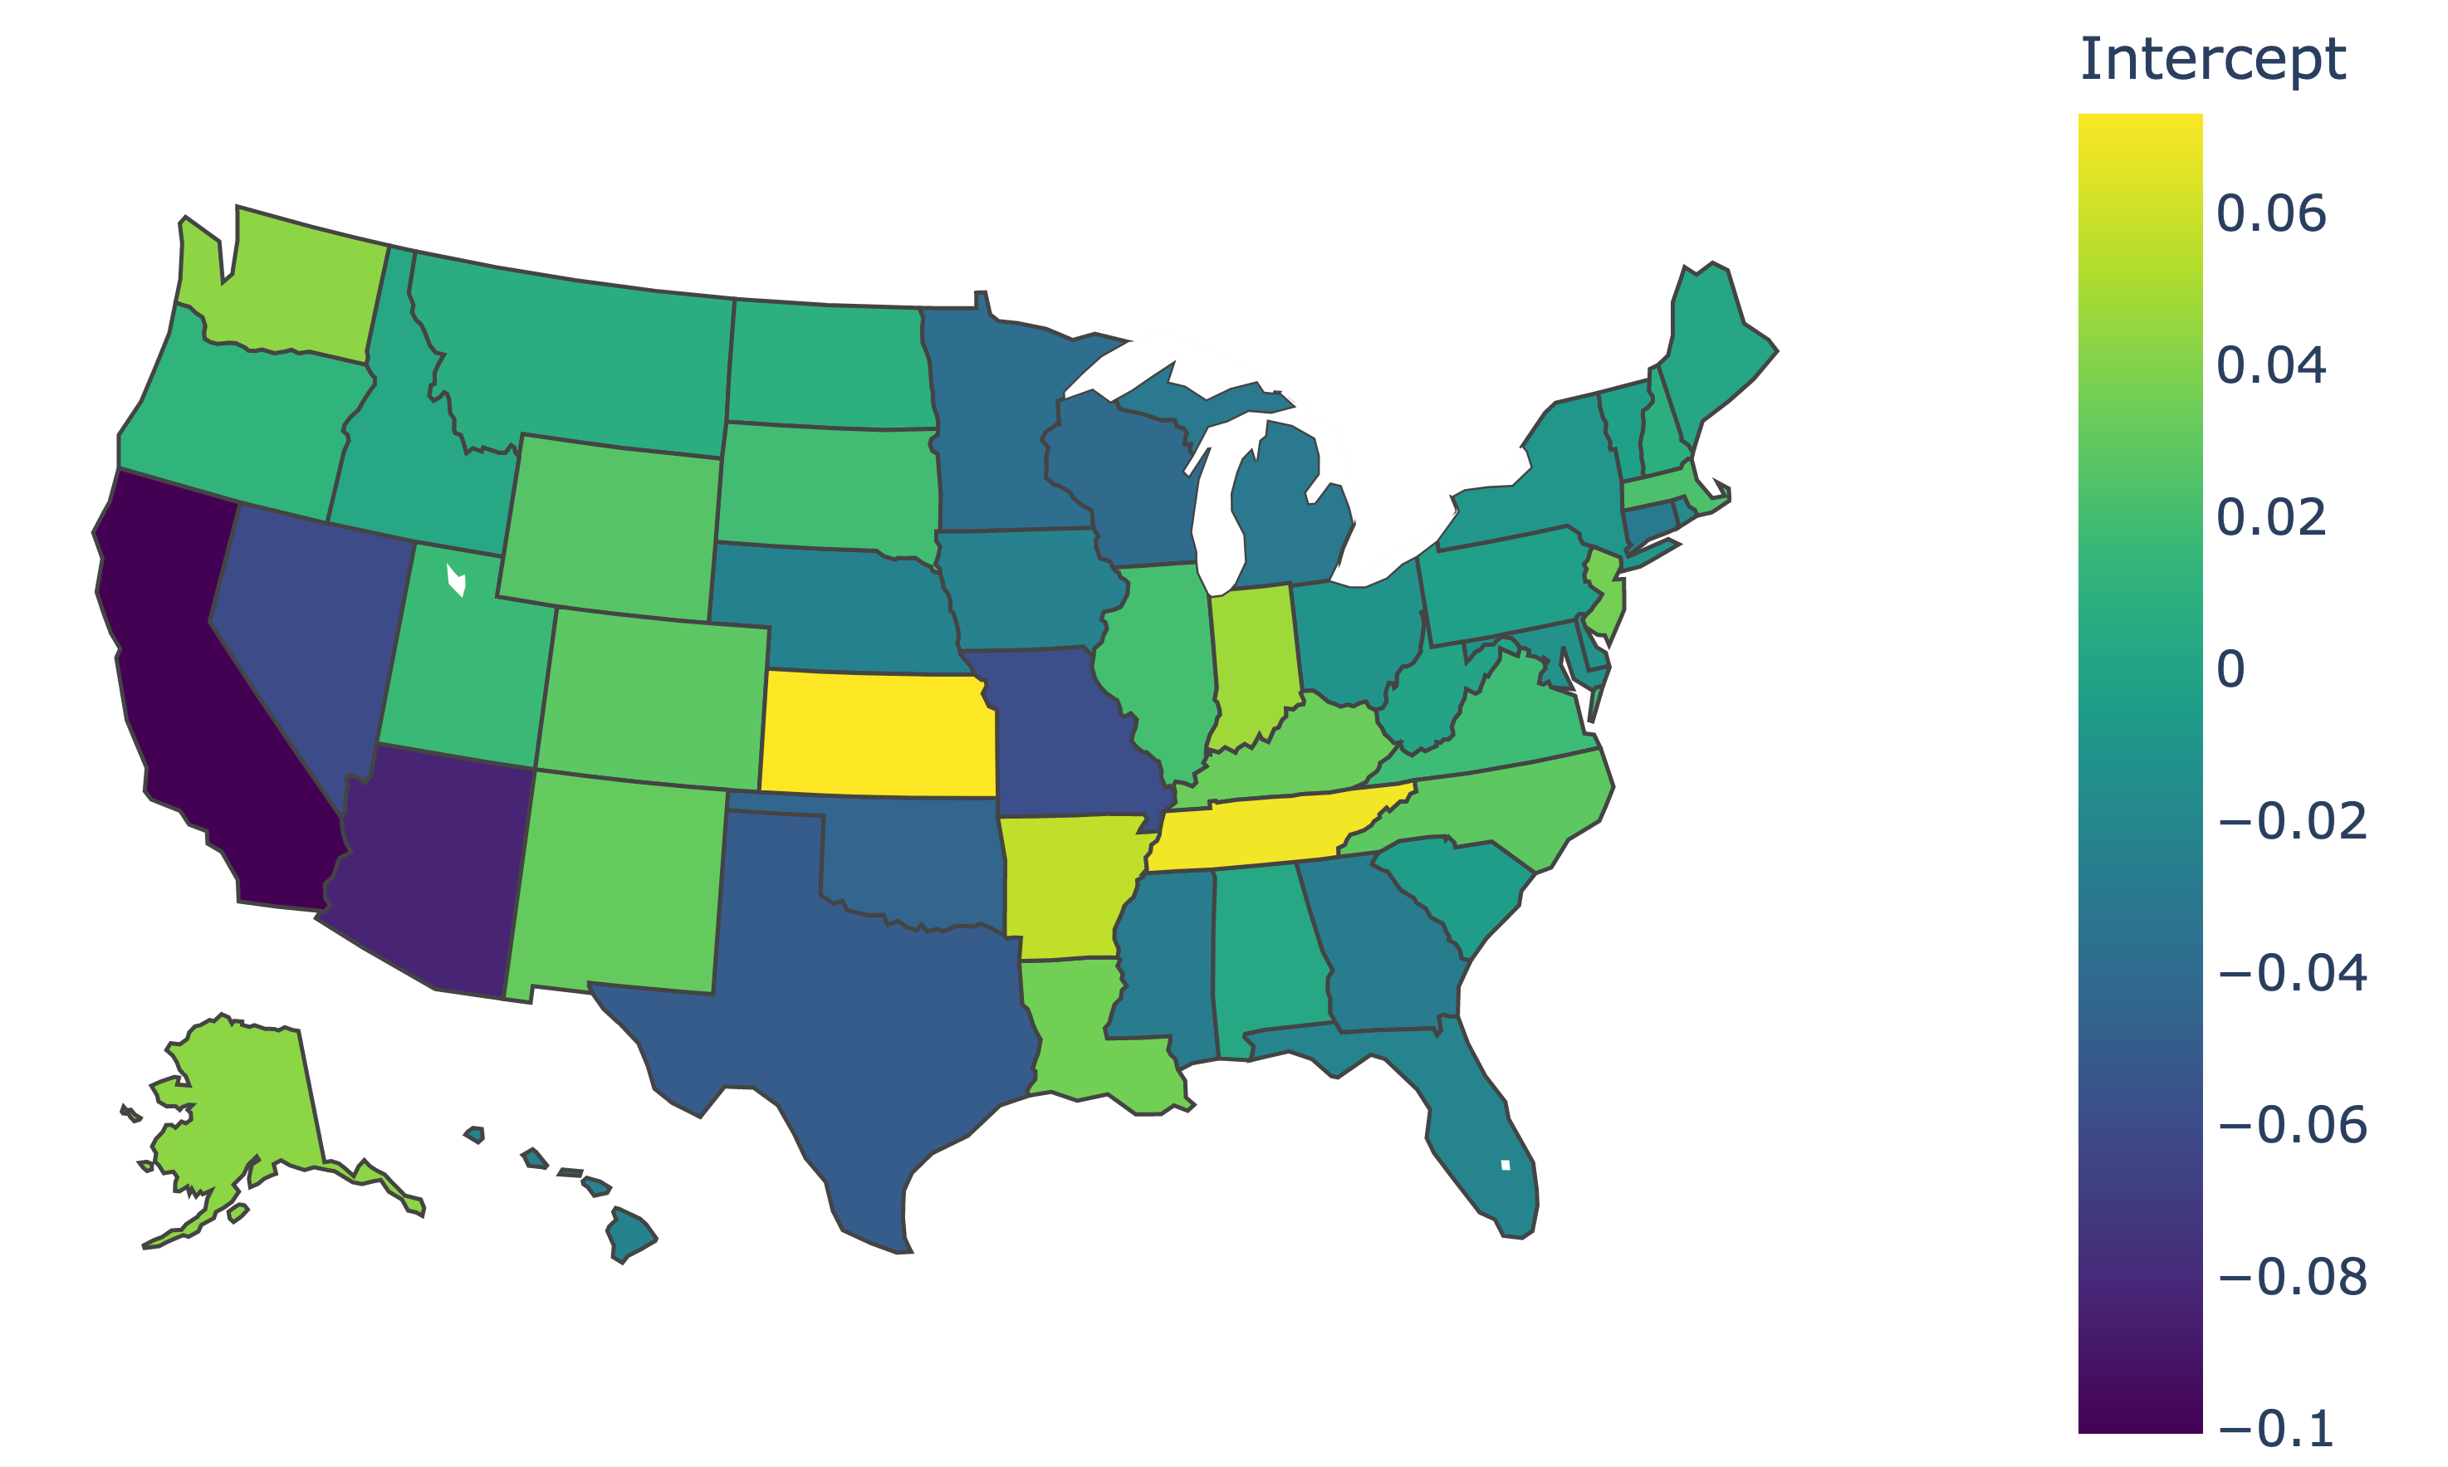
Geographical Visualization
Notes:
Moritz

Slide 12
References
TBD

Slide 13
Title
Subtitle
Notes:
Moritz

